Slide 1
Sales’Up Data Management for Creatio
Your personal assistant in data management
February 12, 2024

Slide 2
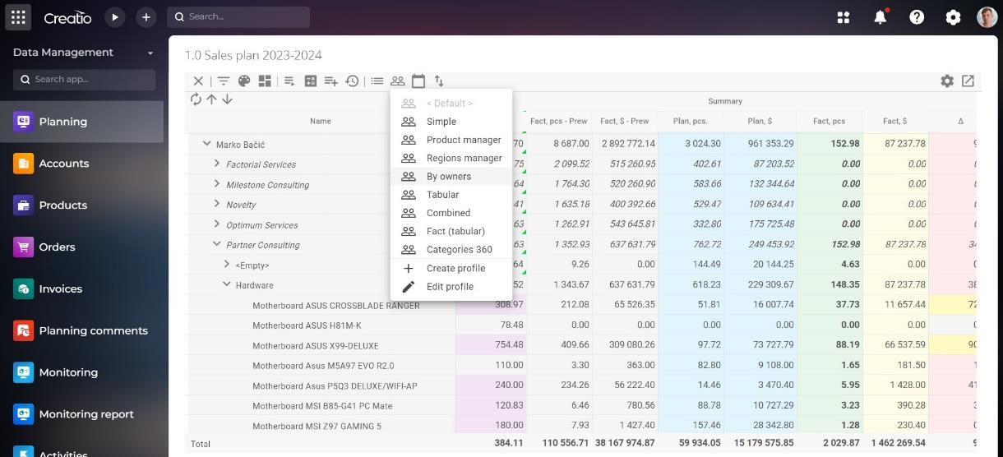
Sales'Up Data Management for Creatio is a multi-purpose tool which provides you with data management and analytics either of the whole enterprise, department or individual groups of employees. Moreover, the product includes plan-fact analysis.
Helps effectively manage financial and quantitative indicators at various organization levels. Facilitates managers and teams in using data to make strategic decisions, identify trends, and improve productivity.

Slide 3
Key features and use cases

Slide 4
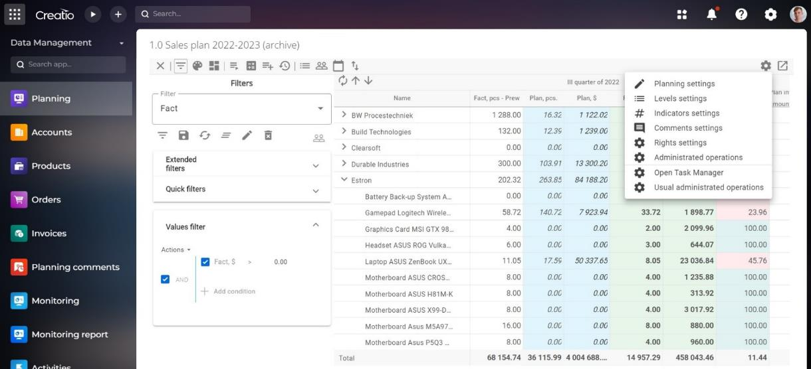
Maintaining a budget at the level of the entire company: Ability to store and compare versions when relocating or changing the amount of funds
Strategic planning of sales department: Possibility of planning from the bottom up and vice versa for medium and large sales departments
Comparison of planned and factual values of sales: Analysis of planned and factual values of sales on different levels including possibility of detailing to a business unit or individual employee
Calculation of employees’ KPI online: Monitoring and evaluation of employees’ efficiency by key performance indicators

Slide 5
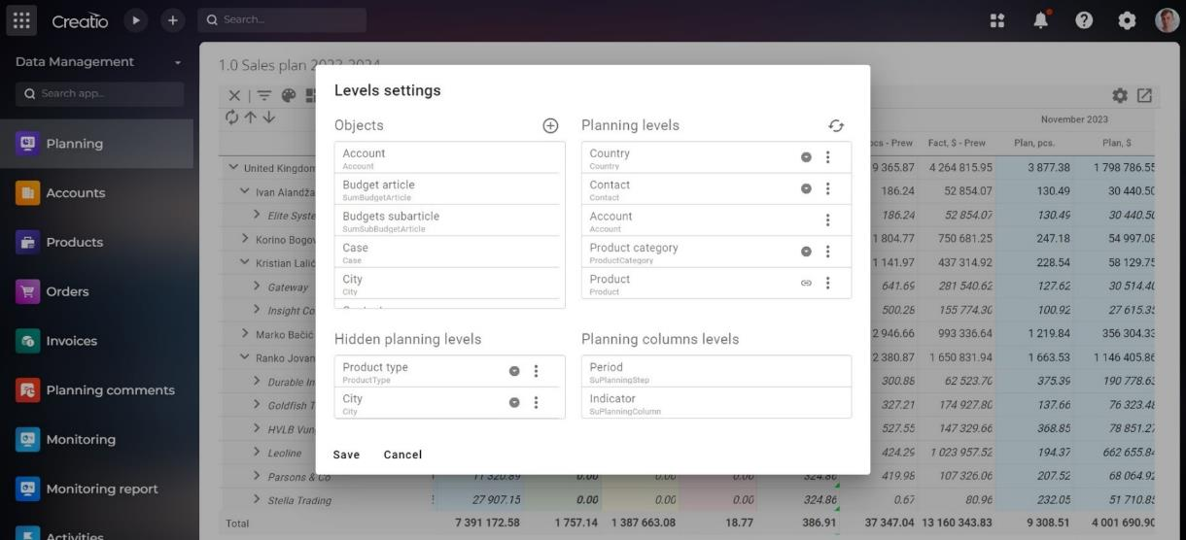
Work with individual user periods: Ability to set individual user periods
Use of advanced mathematical formulas and logical operators: for complex calculation and logical operators
Export plan versions to Excel format: Ability to instantly edit the structure
Detailed logging: Access to various filtering and formatting options of customized planning reports.
Filters by roles: Configuration of data access

Slide 6
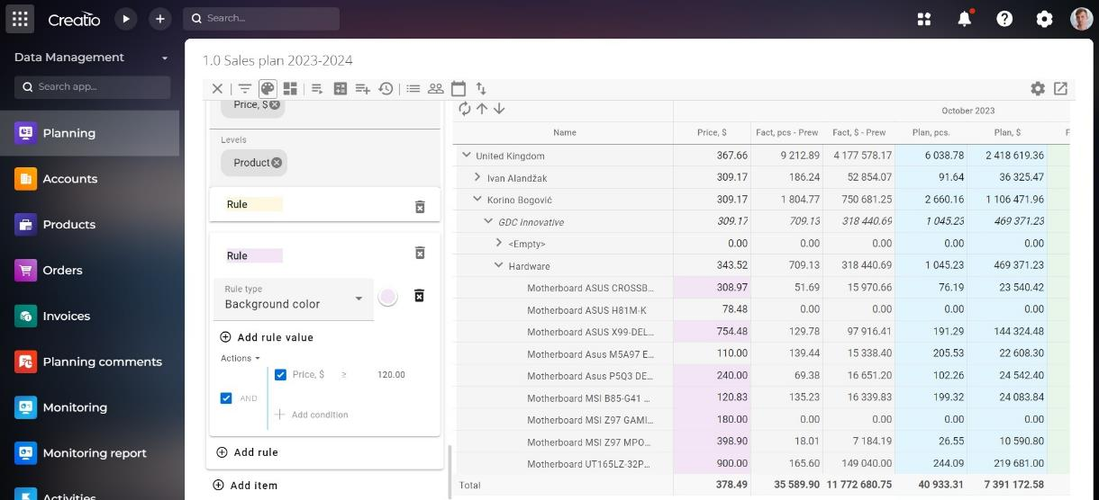
Drag&Drop data tree structure editor: Convenient data structure management through drag-and-drop functionality
Flexible data formatting: Various formatting parameters for easy perception and understanding
User profile settings: Display of essential data for each individual user
Easy data access through widgets:
Displaying planning results as a page element using a widget

Slide 7
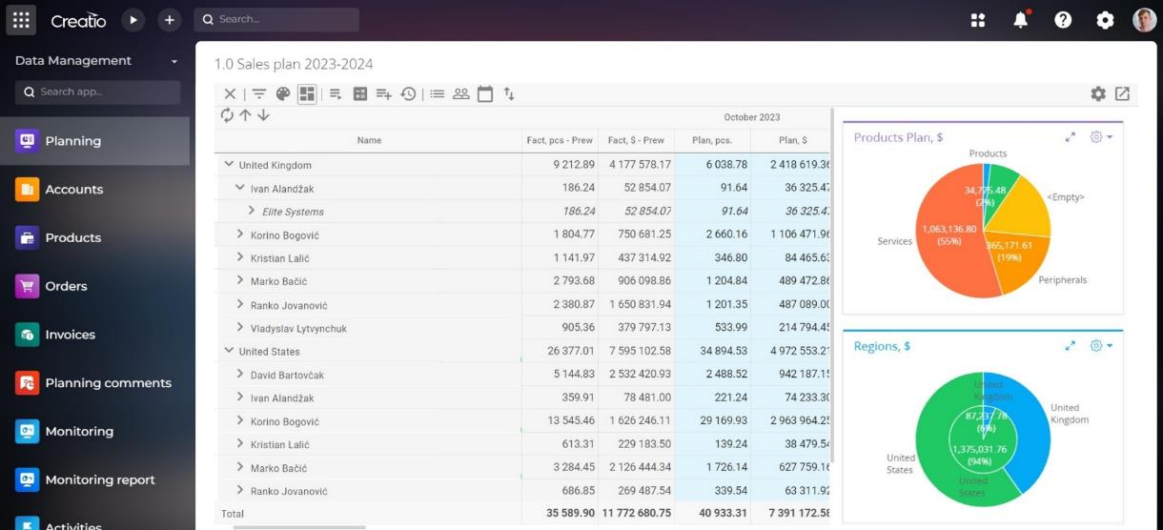
Advanced filtering and dashboard panel: Detailed filtering and data visualization
Flexible data analysis from various sources: Ability to combine data from different planning reports
Forecast: Making forecasts and their interaction with other planning reports

Slide 8
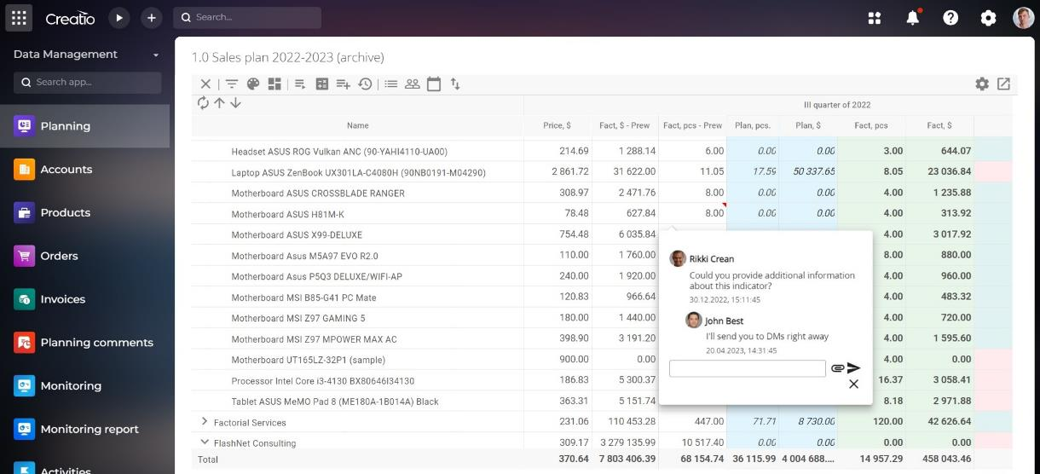
Versatility:
Flexible adaptation to different industries: Regardless of whether a company operates in finance, medicine, manufacturing, or commerce, the product provides the ability to adapt to the specific needs and requirements of each industry.
Advanced analytics:
Ability to operate with big data and to perform complex analysis enables companies to make informed strategic decisions.

Slide 9
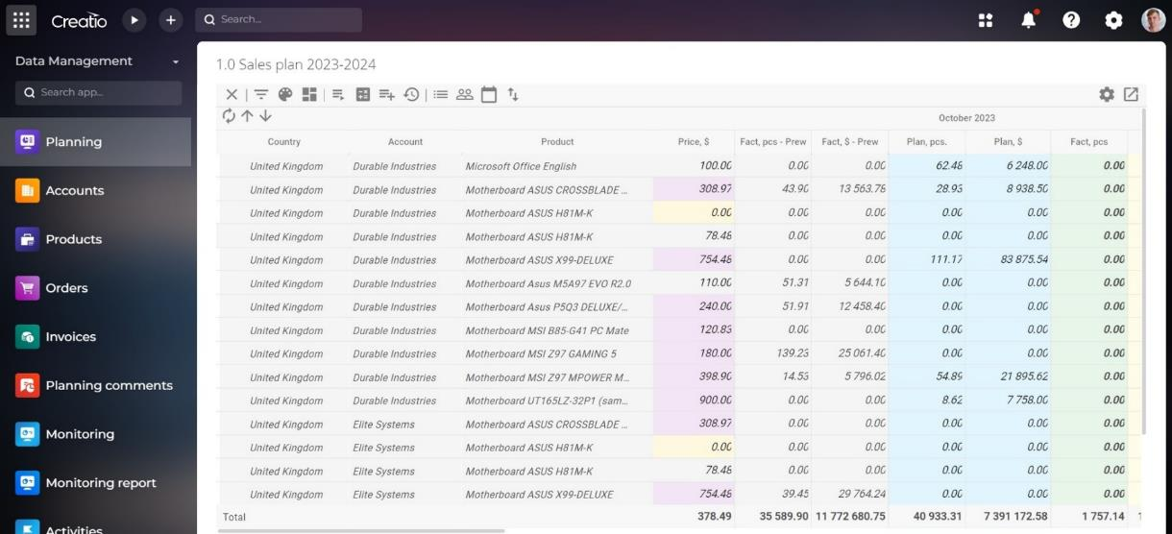
Versatility:
Multi-functional tool for big and small enterprises: The product provides ability for data management and analytics for various operational scales. It can be used both for SMEs and large corporations.
Data processing efficiency:
The product can operate with big data providing fast and efficient analysis which can become a key solution for large corporations with large information volumes.

Slide 10
Usage of
Sales’Up Data Management for Creatio in various industrial branches

Slide 11
FMCG
Analysis of sales data, including sales volumes and dynamics over different periods, best sellers definition
Effective inventory management, goods demand forecast,reduction of risks regarding with optimal stocks.
Forecast of goods demand
Management of promotions and discounts through analysis of marketing activities, sales, special offers for customers or product groups.
Monitoring of competitors, their pricing policies, marketing strategies and product range with aim to develop own strategies and increase competitiveness.

Slide 12
Financial sector
Monitoring of financial indicators such as profit, losses, asset turnover, liquidity, etc.
Analysis of various kinds o risks, such as credit, market and operational risks, etc. Fast implementation of measures to minimize them.
Audits for internal procedure violations and compliance with regulatory requirements.
Managing data over different periods to personalize customer service, provide consultations, and recommend individual financial product offer.
Risk monitoring and fraud prevention. The product helps to determine potential fraud activities and unusual financial transactions. It can reduce the risk of financial losses and increase customer trust.

Slide 13
Banking sector
Automatic analysis of financial statements of legal entities, including cash and non-cash settlements;
Formation of KPI evaluation models of employees, bank divisions;
Analytical sections on the assessment of banking products;
Setting up customer base analysis models, with the possibility of KPI calculations of accounts for further segmentation processes;
Plan-fact analysis of product sales by region and segment (loans, deposits);
Budget planning in terms of branches/departments/subdivisions;
Asset/liability portfolio planning taking into account outflow coefficients;
Liquidity forecasting taking into account various factors/coefficients;
Cost planning models (OPEX, CAPEX).

Slide 14
IT companies
Expenses and resource planning for IT-projects launch.
Time management regarding such levels as task, subproject or project
Planning and monitoring of technical resource usage
KPIs’ analysis for strategic planning.
Marketing efficiency analysis
Analysis of customer inquiries through various channels - email, chats, phone calls, self-service portals, etc.
Analytical reports for management to make strategic decisions.

Slide 15
Pharmacy
Pharmaceutical inventory management, planning of effective medicine delivery to selling points.
Sales efficiency analysis of medicine, considering their types and categories.
Monitoring of market demand based on sales and consumer feedback to create optimal product range in time
Marketing efficiency analysis and launching of new promo initiatives
Expenses forecast for new medical production.
Analysis of sales by country, region, and city to optimize cooperation with pharmacy chains.

Slide 16
E-commerce
Monitoring and optimization of goods in stock
Analysis of promo activities and discounts impact on profitability and sales volumes
Goods demand forecast based on historical sales data
Goods purchases and supplies are planned according to demand forecast.
Monitoring of competitors' prices for goods.
Analysis and planning of logistics costs.

Slide 17
AGRO Management
Analysis of production volumes for different crops, including harvest forecast based on historical data, weather conditions, and agronomy.
Optimization of stocks, planning of deliveries and product sales.
Analysis of production expenses, including some goods procurement, equipment rent and salaries.
Risk analysis concerning weather conditions, market fluctuations, etc., and their further prevention.
Control of resource usage to optimize and conserve them.
Use of data reports for agricultural promotion, organizing farmers' markets, and other agro events.

Slide 18
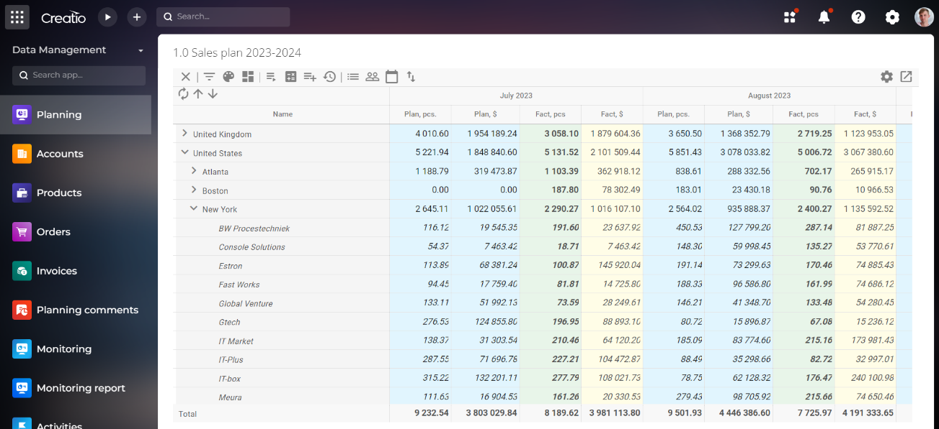
Example of configuring a data slice:
Sales plan based on previous year data history of counterparties by country and city
Setup time of a data spreadsheet in Data management for Creatio is one hour.

Slide 19
Row edition
Dynamic period of indicators calculation
What’s new?
Gives ability to edit specific indicators in certain rows. For example, a manager can see all rows of his department, but in the Plan column, he can only edit clients for whom he is responsible for.,
Ability to show the period in the indicator (similar to dynamic profiles), that should be calculated during automatic planning updates (for productivity growth). The 'Calculate All' action ignores this setting. For example, if in daily planning in the indicator is calculated total shipments per day, than by January 8. it is useless to calculate 300 days ahead till the end of the year, as there will be only zeroes. This can be changed and the system can consider only last two weeks and current day.
Operation rights
Great variety of rights for more flexible access management
Dynamic period profile
Unlimited number of columns in planning reports
Ability to set dynamic period profile so that it will be able of everyday adaptation by concrete dates. For example it can show previous 7 days and next 3 days (for the 8th day of the month, this would be the period from the 5th to the 14th).
Now you can build planning, for example, on a daily basis for 5+ years (2K periods and columns in a grid)

Slide 20
What’s new?
Data shifting
Edited indicator levels
Ability to shift or copy any data from one cell to other using different records, periods and indicators.
The ability to configure, for each indicator, which levels can have planned data entered. For example, with filled levels such as Counterparty and Product Category, rows at higher levels are blocked for the user, and there is no possibility to enter data in the Counterparty to distribute it across all products.
Adaptation to Shell
Virtual rows
Fixed style issues in the new interface
Now it is possible to create links between levels only for building up, not for display (for system productivity growth).

Slide 21
THANK YOU
Contacts:
salesup-it.com
care@salesup-it.com

