Slide 1
Sales’Up Checklists for Creatio
Automation of routine repetitive operations
23.02.2024

Slide 2
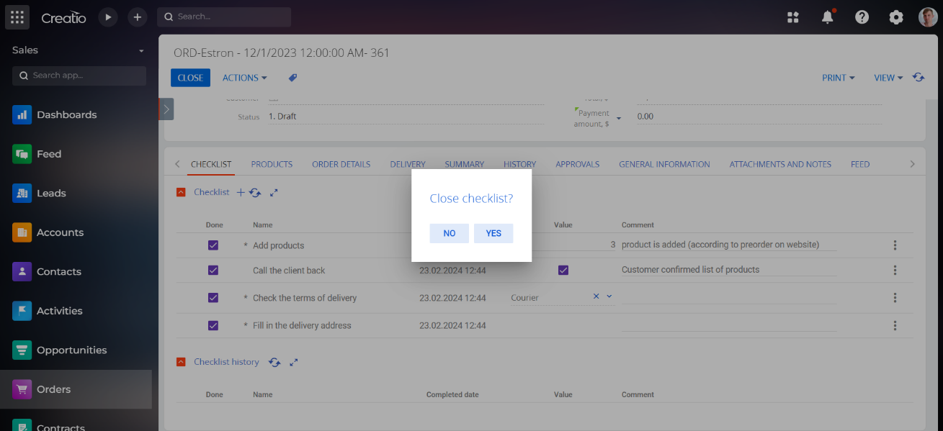
Sales’Up Checklists for Creatio - is a product that revolutionizes business process management by replacing variety of routine operations with convenient checklists.
It helps to create individual checklists for each stage of the workflow, also you can use such settings as mandatority or type of result.
This tool helps companies to gain effective control over processes. Checklist history allows to make efficiency analysis. It simplifies business management by transforming complex processes into simple and structured control systems.

Slide 3
Main functions and use cases

Slide 4
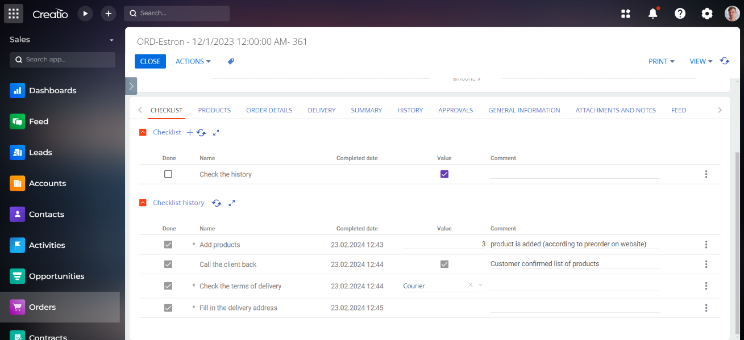
Checklist features:
The user can define the sequence, mandatority, and follow-up tasks at each step of any workflow facility
Employee task storage optimization:
Product helps to clear the schedule from repetitive activities, simplifying the task storage process
List of documentation from the customer at any stage:
Sale conducting, ordering, marketing activities, case processing

Slide 5
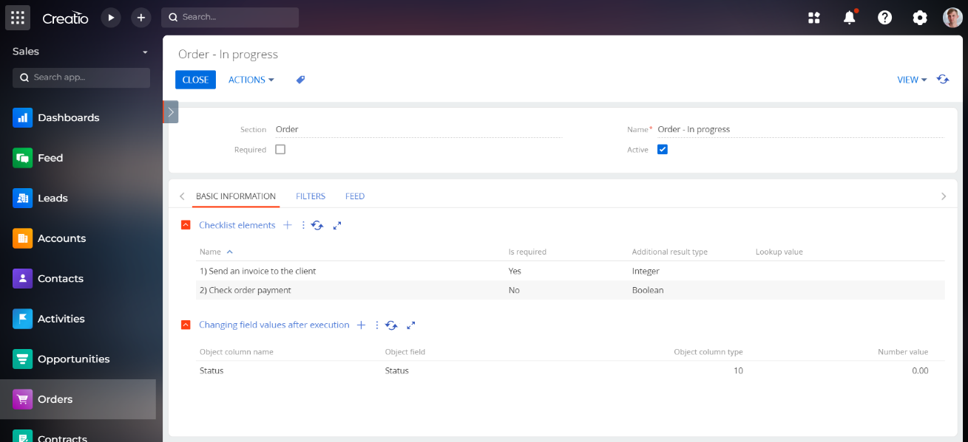
Checklist Settings:
Checklists allow maintaining a list of tasks without being bound to a chronology
Setting up the mandatority for each one from the item list
Storing files related to each item
Keeping track of each item's due date
Storing checklist history.
Changing the status of an object upon a checklist completion

Slide 6
Industrial use cases of
Sales’Up Checklists for Creatio

Slide 7
Pharmacy
Systematization and control of production stages, including raw material registration, manufacturing, quality control, and packaging.
Organization and control of clinical trials, including data collection, reporting, and compliance with requirements.
Preparation and systematization of documents for medicines registration, updating of registration dossiers.
Management of production processes and quality control during the manufacturing of medical equipment, ensuring compliance with safety and efficiency standards;
Organization and control of logistics - raw material supply, manufacturing, packaging, and delivery.
Checklists for audits and inspections to meet internal and external requirements.

Slide 8
Food industry
Control over production cycle, including raw material supply, manufacturing, packaging, and product labeling.
Checklists implementation to ensure compliance with production safety and quality standards.
Monitoring of raw material and ready production inventories, considering expiration dates and storage conditions.
Control of beverage production, including recipes, filtration processes, and packaging.
Implementation of checklists for ensuring compliance with food safety standards and production processes.
Organization and control of logistics, including raw material delivery, distribution of goods, and warehouse management.

Slide 9
Banking
Implementation of checklists to ensure compliance of financial processes with internal and external standards and regulations.
Systematization of risk control operations, including assessment, monitoring and reporting.
Checklists for preparing financial reports, including balance, incomes, and cash flow statements.
Management of tax planning, in accordance with up-to-date tax laws and standards.
Systematization of asset and investment portfolio management, aimed at income growth and risk reduction.
Checklists for financial transactions control, such as payments, transfers, and other financial operations.

Slide 10
Tourism
Using checklists to control the process of booking hotels, tours, and other tourist services.
Systematization of providing tourist services, such as checking of documents availability, transportation and accommodation.
Checklists for tours and journey planning, including all necessary equipment and documents
Implementation of checklists to ensure compliance with safety and health standards during the vacation period.
Control of tourist events, such as conferences, festivals, and guided tours.
Checklists for monitoring and control of financial operations, such as salaries, expenses and reports.

Slide 11
Construction and Real Estate
Implementation of checklists for managing various stages of construction projects, including planning, construction, quality control and safety.
Process systematization of construction works quality control.
Checklists to ensure compliance with safety regulations at construction sites.
Maintaining checklists for monitoring expenses and resources within construction projects.
Electronic documentation for construction projects, including completed work certificates, technical specifications, etc
Checklists for implementing and ensuring compliance with quality standards and building regulations

Slide 12
Retail
Using checklists for monitoring goods in stock, inventory management, and supplies.
Systematization of store management processes, such as installation of window displays, merchandising, and cleanliness control.
Implementation of checklists for sales and KPIs control.
Checklists for staff training, performance evaluation, and monitoring of business processes.
Implementation of checklists to ensure customer service standards, including order processing and client communication.
Implementation of checklists for promo activities planning and performance

Slide 13
Example:
Checklist for a sales manager working with orders. Preparation of order information and its execution
Setup time of a checklist is 20 minutes

Slide 14
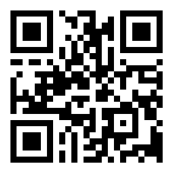
THANK YOU!
CONTACT US:
salesup-it.com
care@salesup-it.com

