Slide 1


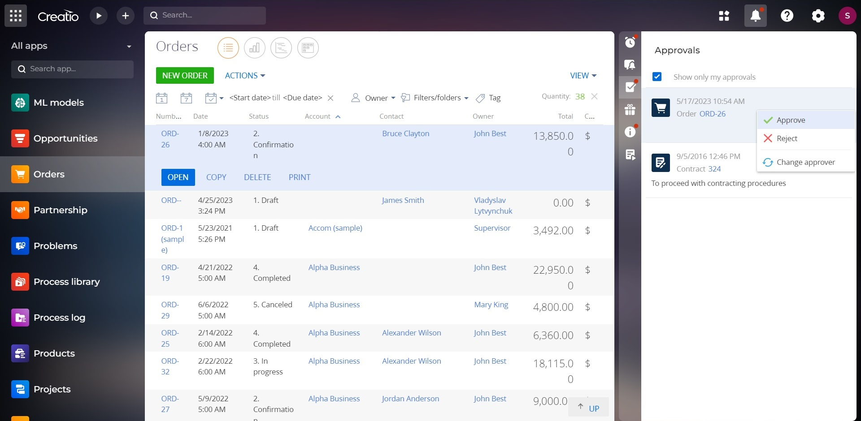
Approval for Creatio
Accelerate the approval process

Slide 2

Approval for Creatio
Approval workflow for any section of Creatio that allows for parallel and sequential approvals of cases of any complexity.
Approval for Creatio is a product that allows you to create a parallel, sequential, and mixed approval processes of any complexity.
Notes:
First of all, we normalize the client base and set up categorization and segmentation. The system allows you to use absolutely any information to categorize clients, from the size of the land bank to the number of goods purchased from us.
Also we calculate the potential of each client based on his land bank and grown
crops. Based on this information, we can prioritize the work of the manager and understand which customer have the maximum potential.
Also we maintaining information about competitor’s products to help the manager more carefully prepare for meetings with the client and consider with whom the client compares us.
and of course analytics. The system allows you to build analytics on any data that is in the system in any slices and views. this will allow you to analyze information in the most convenient form in a single system

Slide 3
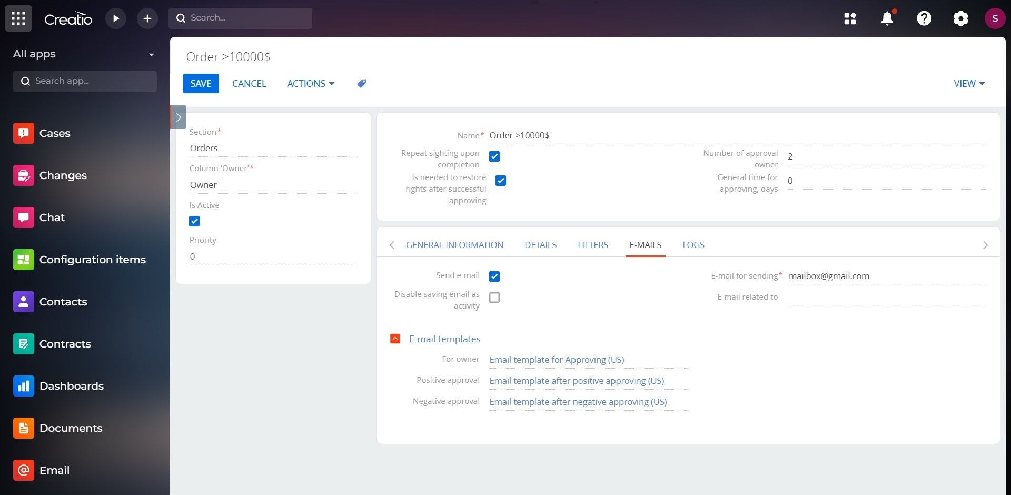
Approval for Creatio
Use cases:
Setting up a new approving pattern is conveniently implemented in a separate section in Creatio. With this application you can create both simple and branched approval processes. You can also include different rules for the transition from one approval stage to another.
Notes:
First of all, we normalize the client base and set up categorization and segmentation. The system allows you to use absolutely any information to categorize clients, from the size of the land bank to the number of goods purchased from us.
Also we calculate the potential of each client based on his land bank and grown
crops. Based on this information, we can prioritize the work of the manager and understand which customer have the maximum potential.
Also we maintaining information about competitor’s products to help the manager more carefully prepare for meetings with the client and consider with whom the client compares us.
and of course analytics. The system allows you to build analytics on any data that is in the system in any slices and views. this will allow you to analyze information in the most convenient form in a single system

Slide 4
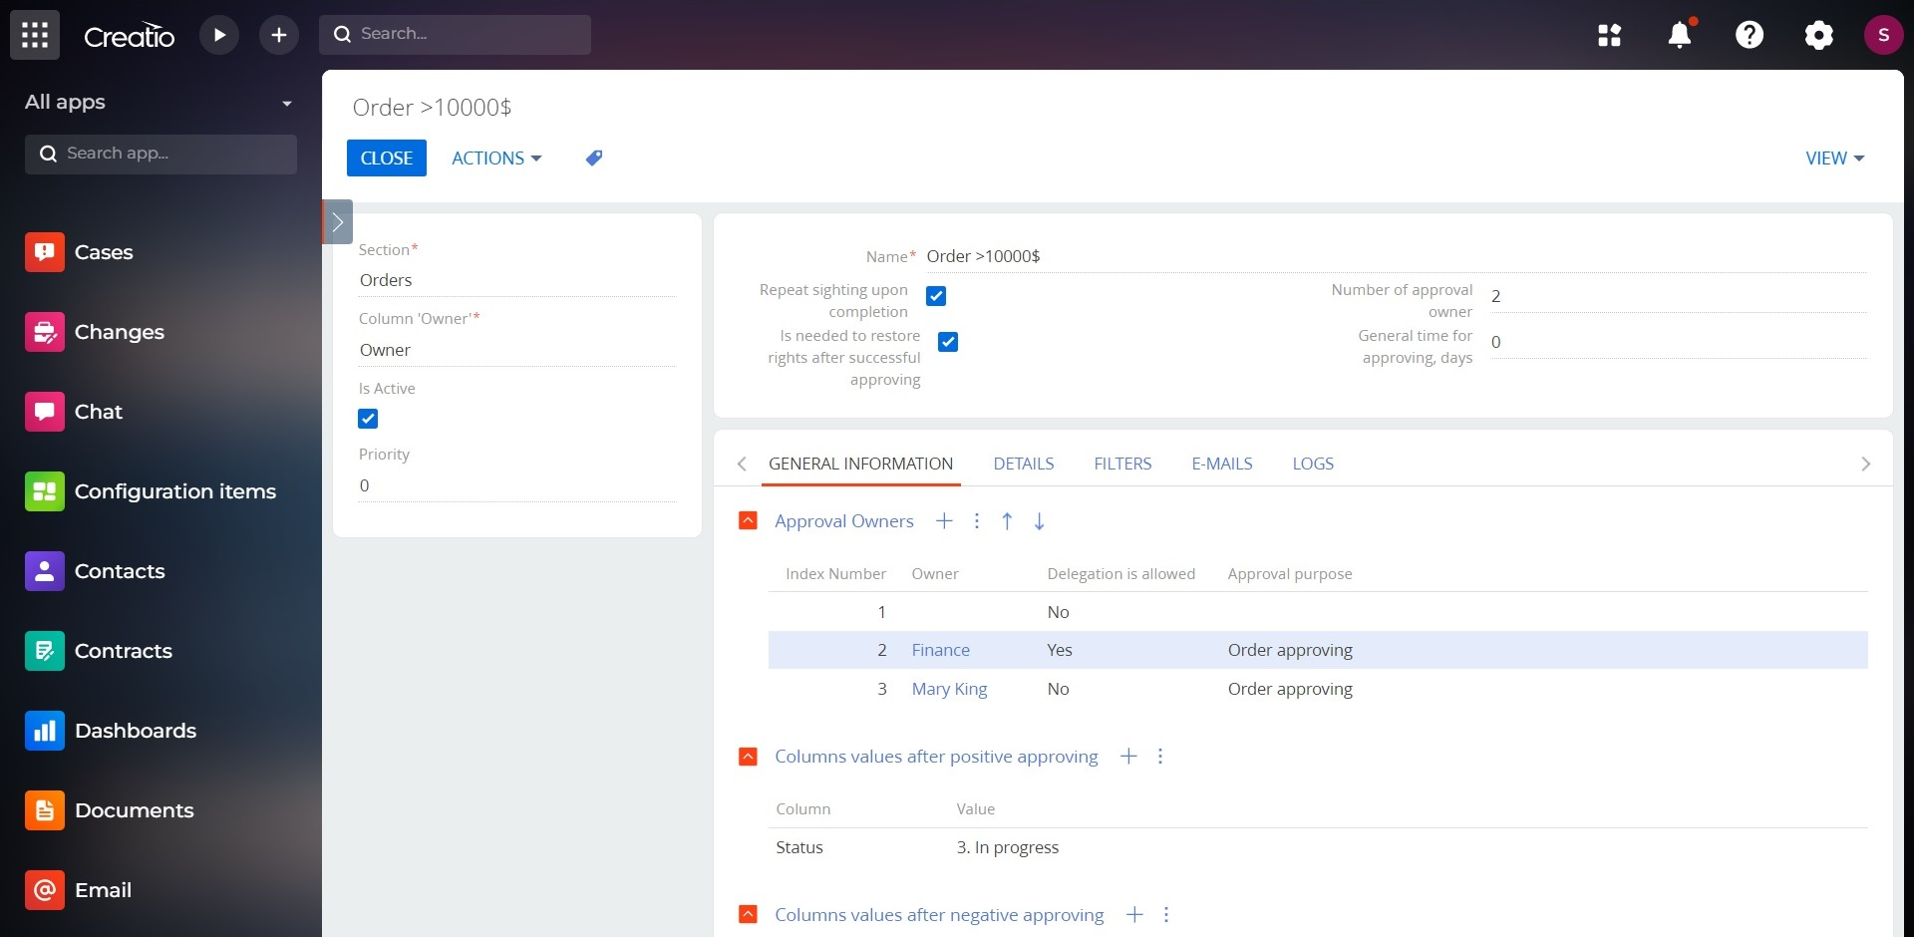
Approval for Creatio
Key features:
Customize the approval sequence within your company considering both job roles and specific employees for the process.
Set serial, parallel, and mixed approvals within the same approval workflow.
Set up an automatic launch of the approval process for any conditions using advanced filter functionality
Notes:
First of all, we normalize the client base and set up categorization and segmentation. The system allows you to use absolutely any information to categorize clients, from the size of the land bank to the number of goods purchased from us.
Also we calculate the potential of each client based on his land bank and grown
crops. Based on this information, we can prioritize the work of the manager and understand which customer have the maximum potential.
Also we maintaining information about competitor’s products to help the manager more carefully prepare for meetings with the client and consider with whom the client compares us.
and of course analytics. The system allows you to build analytics on any data that is in the system in any slices and views. this will allow you to analyze information in the most convenient form in a single system

Slide 5
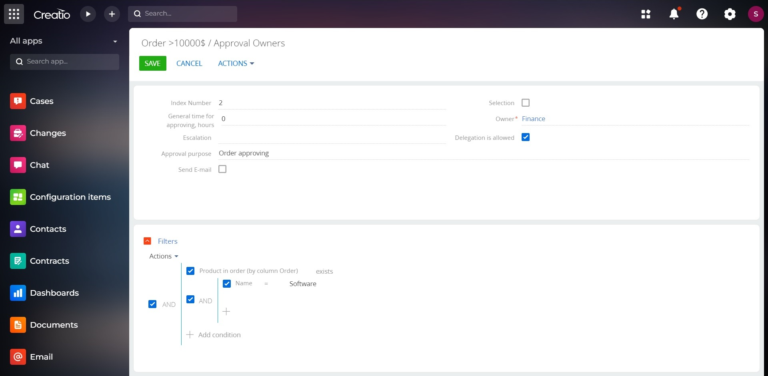
Approval for Creatio
Key features:
Set up the rules for changing any fields of a record that has been approved. For example there is no need to manually change the agreement status to the “Agreed” after visa approval. The system will do it automatically.
If the approval is rejected, the system will automatically send a notification to a user with a comment from a person who rejected it.
Multilingual email templates are supported. Users will receive notifications in the language indicated on the Contact section card in the "Preferred language" column.
Notes:
First of all, we normalize the client base and set up categorization and segmentation. The system allows you to use absolutely any information to categorize clients, from the size of the land bank to the number of goods purchased from us.
Also we calculate the potential of each client based on his land bank and grown
crops. Based on this information, we can prioritize the work of the manager and understand which customer have the maximum potential.
Also we maintaining information about competitor’s products to help the manager more carefully prepare for meetings with the client and consider with whom the client compares us.
and of course analytics. The system allows you to build analytics on any data that is in the system in any slices and views. this will allow you to analyze information in the most convenient form in a single system

Slide 6
Approval for Creatio
When a status of an order is changed to «Approving», the approving process starts. If an order’s sum is bigger than 20 000, then an order has to be approved by finance department; if an order’s sum is bigger than 50 000, it has to be approved by a head of finance department. After an order is approved, its status automatically changes to «In progress».
Notes:
First of all, we normalize the client base and set up categorization and segmentation. The system allows you to use absolutely any information to categorize clients, from the size of the land bank to the number of goods purchased from us.
Also we calculate the potential of each client based on his land bank and grown
crops. Based on this information, we can prioritize the work of the manager and understand which customer have the maximum potential.
Also we maintaining information about competitor’s products to help the manager more carefully prepare for meetings with the client and consider with whom the client compares us.
and of course analytics. The system allows you to build analytics on any data that is in the system in any slices and views. this will allow you to analyze information in the most convenient form in a single system

Slide 7
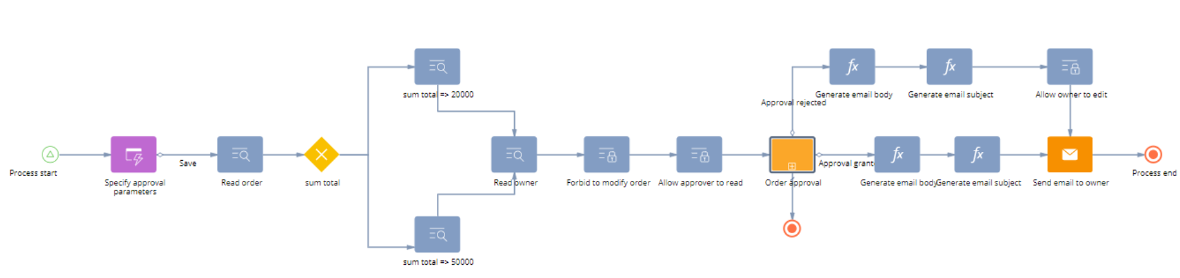
Approval for Creatio
Configuring the process of approval through Creatio business processes:
Setup time needed for a Sales’Up analyst is 7 hours

Slide 8
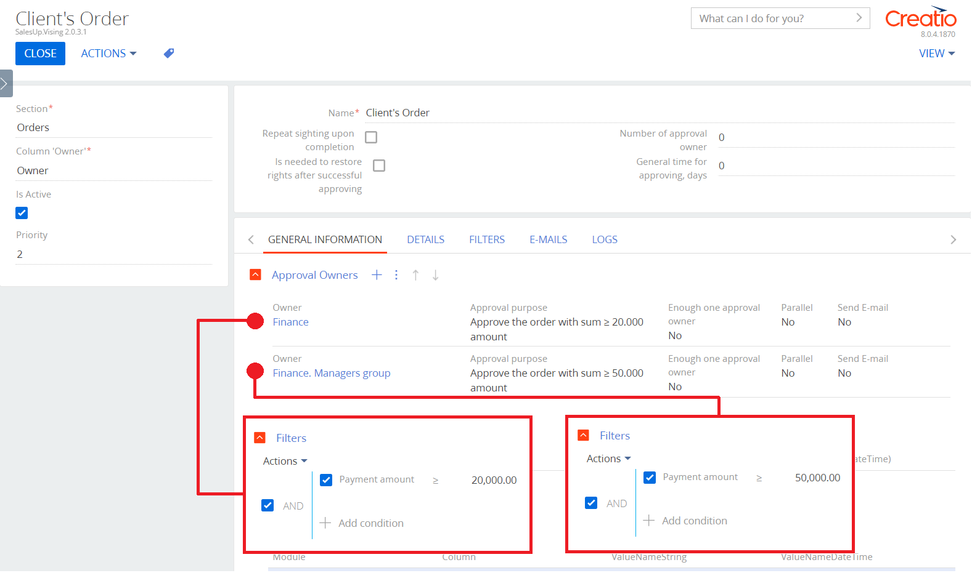
Approval for Creatio
Configuring the process of approval through Approvals for Creatio:
Setup time is 30 minutes;
It is possible to setup different conditions for sighting process participants in one setting;
Easily changed conditions of a sighting process.
Notes:
First of all, we normalize the client base and set up categorization and segmentation. The system allows you to use absolutely any information to categorize clients, from the size of the land bank to the number of goods purchased from us.
Also we calculate the potential of each client based on his land bank and grown
crops. Based on this information, we can prioritize the work of the manager and understand which customer have the maximum potential.
Also we maintaining information about competitor’s products to help the manager more carefully prepare for meetings with the client and consider with whom the client compares us.
and of course analytics. The system allows you to build analytics on any data that is in the system in any slices and views. this will allow you to analyze information in the most convenient form in a single system

Slide 9

Approval for Creatio
CONTACT US:
salesup-it.com
care@salesup-it.com
Notes:
First of all, we normalize the client base and set up categorization and segmentation. The system allows you to use absolutely any information to categorize clients, from the size of the land bank to the number of goods purchased from us.
Also we calculate the potential of each client based on his land bank and grown
crops. Based on this information, we can prioritize the work of the manager and understand which customer have the maximum potential.
Also we maintaining information about competitor’s products to help the manager more carefully prepare for meetings with the client and consider with whom the client compares us.
and of course analytics. The system allows you to build analytics on any data that is in the system in any slices and views. this will allow you to analyze information in the most convenient form in a single system

