Slide 1


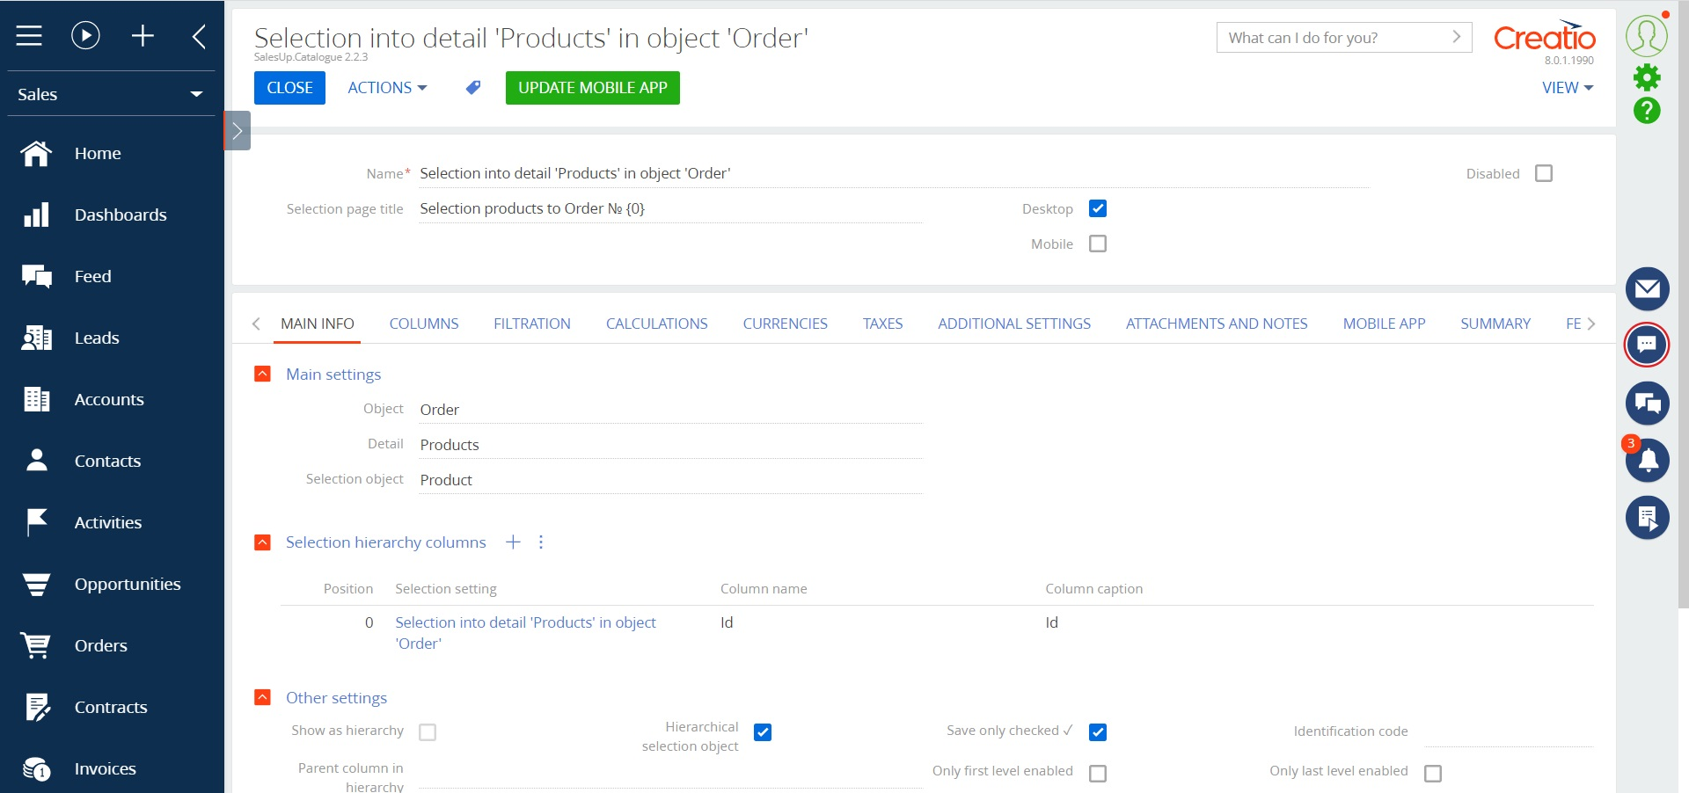
Catalog selection enhancements for Creatio
Catalog selection enhancements for Creatio - the product is designed to simplify work with catalogs in the system. It helps to filter the necessary records automatically, set up a hierarchy of selection, add the necessary records to the detail conveniently and quickly.
Notes:
First of all, we normalize the client base and set up categorization and segmentation. The system allows you to use absolutely any information to categorize clients, from the size of the land bank to the number of goods purchased from us.
Also we calculate the potential of each client based on his land bank and grown
crops. Based on this information, we can prioritize the work of the manager and understand which customer have the maximum potential.
Also we maintaining information about competitor’s products to help the manager more carefully prepare for meetings with the client and consider with whom the client compares us.
and of course analytics. The system allows you to build analytics on any data that is in the system in any slices and views. this will allow you to analyze information in the most convenient form in a single system

Slide 2
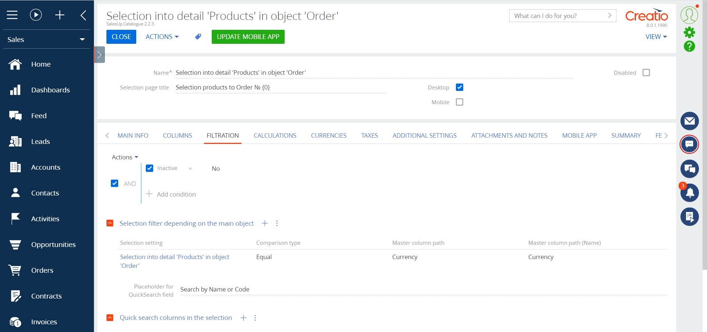
Catalog selection enhancements for Creatio
Use cases:
The product will be useful for companies with a wide range of products for effective organization of the work of users with the selection of products in Creatio.
.
Notes:
First of all, we normalize the client base and set up categorization and segmentation. The system allows you to use absolutely any information to categorize clients, from the size of the land bank to the number of goods purchased from us.
Also we calculate the potential of each client based on his land bank and grown
crops. Based on this information, we can prioritize the work of the manager and understand which customer have the maximum potential.
Also we maintaining information about competitor’s products to help the manager more carefully prepare for meetings with the client and consider with whom the client compares us.
and of course analytics. The system allows you to build analytics on any data that is in the system in any slices and views. this will allow you to analyze information in the most convenient form in a single system

Slide 3
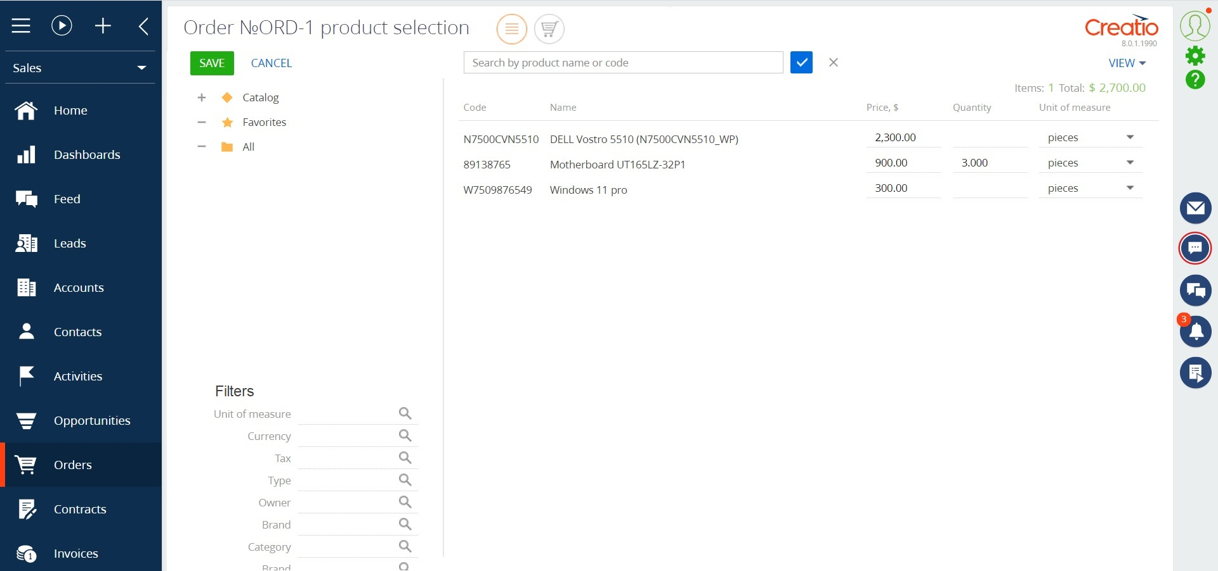
Catalog selection enhancements for Creatio
Key features:
Replacing the standard functionality of adding a record by a catalog and possibility to customize the catalog for any part of the section;
Automatically filter products in the assortment according to the terms of the contract, the client and his needs, so that not all products in the system are displayed on the selection page, but only those that meet the filter criteria;
Organize the list into a tree scheme and add all positions with one click;
Offers two ways to select a product from the selection page to the part;
Notes:
First of all, we normalize the client base and set up categorization and segmentation. The system allows you to use absolutely any information to categorize clients, from the size of the land bank to the number of goods purchased from us.
Also we calculate the potential of each client based on his land bank and grown
crops. Based on this information, we can prioritize the work of the manager and understand which customer have the maximum potential.
Also we maintaining information about competitor’s products to help the manager more carefully prepare for meetings with the client and consider with whom the client compares us.
and of course analytics. The system allows you to build analytics on any data that is in the system in any slices and views. this will allow you to analyze information in the most convenient form in a single system

Slide 4
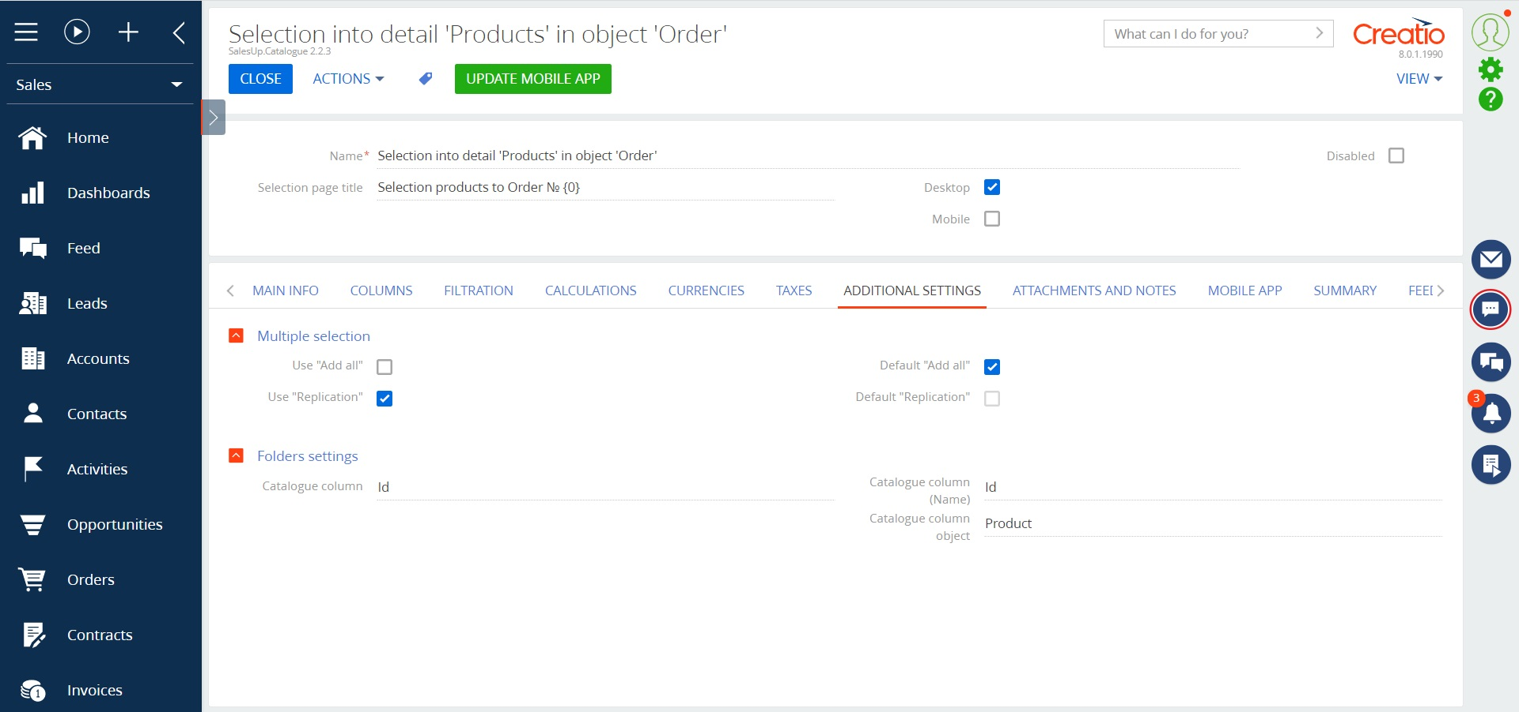
Catalog selection enhancements for Creatio
Key features:
Sort products on the selection page by a column;
Set up filtering not only for object records, but also for the list of products;
Set up filtering of the price history for parts depending on the conditions on the main object, contract;
Specify quick-search columns;
Set up automatic recalculation of the product price, depending on the contract currency.
Notes:
First of all, we normalize the client base and set up categorization and segmentation. The system allows you to use absolutely any information to categorize clients, from the size of the land bank to the number of goods purchased from us.
Also we calculate the potential of each client based on his land bank and grown
crops. Based on this information, we can prioritize the work of the manager and understand which customer have the maximum potential.
Also we maintaining information about competitor’s products to help the manager more carefully prepare for meetings with the client and consider with whom the client compares us.
and of course analytics. The system allows you to build analytics on any data that is in the system in any slices and views. this will allow you to analyze information in the most convenient form in a single system

Slide 5

Catalog selection enhancements for Creatio
CONTACT US:
salesup-it.com
care@salesup-it.com
+38 050 140 11 22
Kyiv, Lobanovskoho Avenue, 119В
Notes:
First of all, we normalize the client base and set up categorization and segmentation. The system allows you to use absolutely any information to categorize clients, from the size of the land bank to the number of goods purchased from us.
Also we calculate the potential of each client based on his land bank and grown
crops. Based on this information, we can prioritize the work of the manager and understand which customer have the maximum potential.
Also we maintaining information about competitor’s products to help the manager more carefully prepare for meetings with the client and consider with whom the client compares us.
and of course analytics. The system allows you to build analytics on any data that is in the system in any slices and views. this will allow you to analyze information in the most convenient form in a single system

