Slide 1


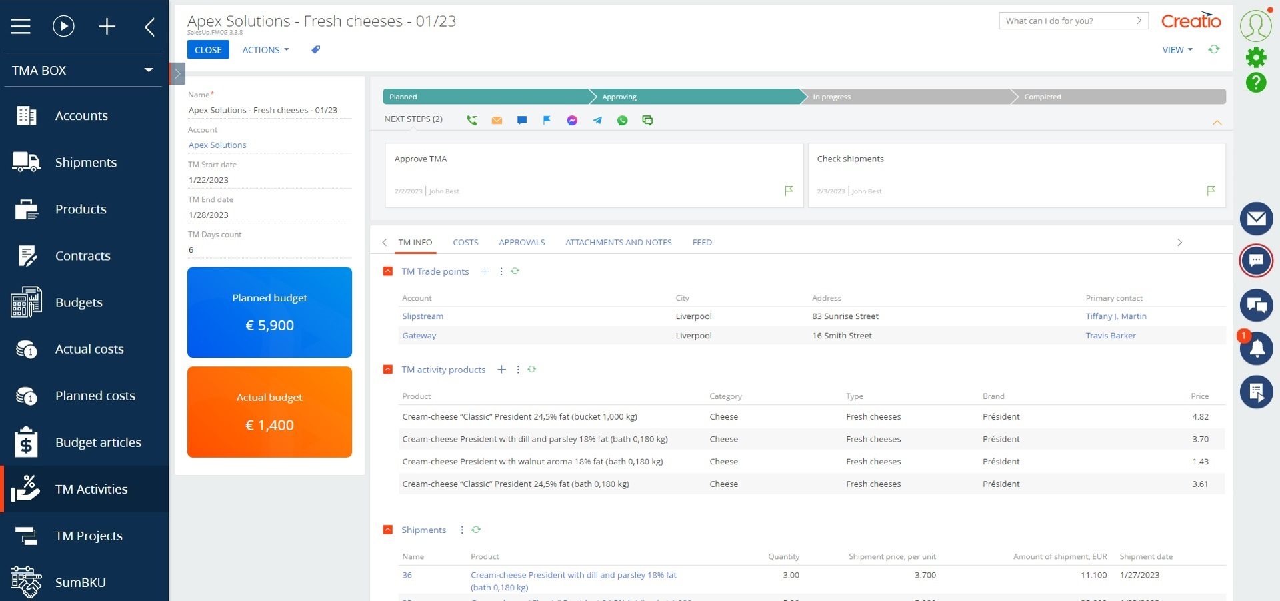
FMCG management
Simple solutions for complex problems

Slide 2

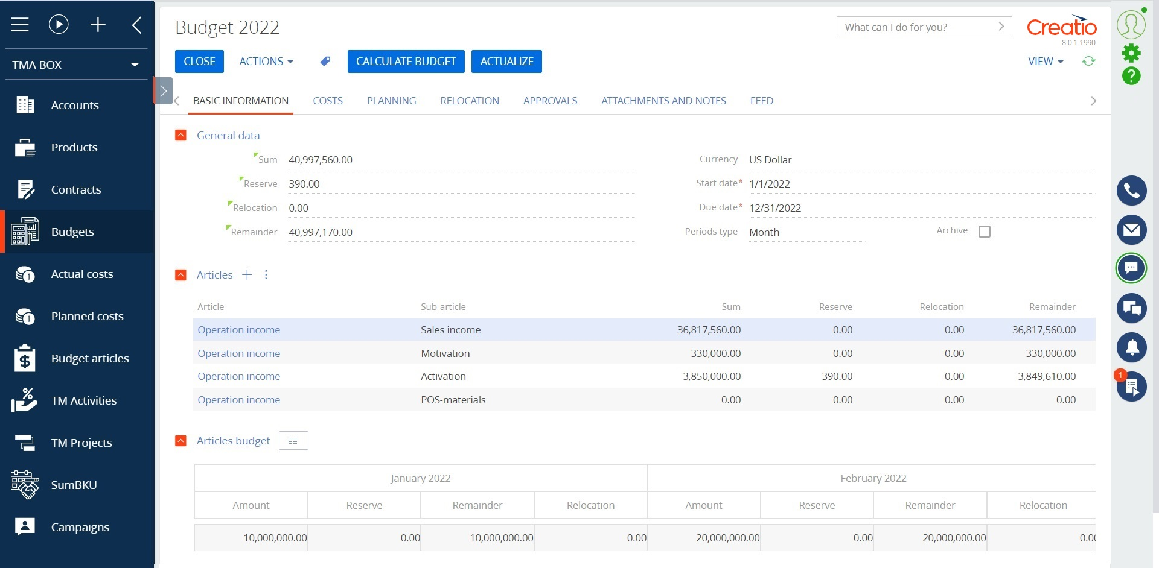
FMCG management for Creatio
FMCG management for Creatio allows you to improve the efficacy of managing trade marketing activities, control the effectiveness of budget use with the help of automating the process of planning trade marketing activities and a tool for analyzing indicators in the context of business units, networks, distributors.
Notes:
First of all, we normalize the client base and set up categorization and segmentation. The system allows you to use absolutely any information to categorize clients, from the size of the land bank to the number of goods purchased from us.
Also we calculate the potential of each client based on his land bank and grown
crops. Based on this information, we can prioritize the work of the manager and understand which customer have the maximum potential.
Also we maintaining information about competitor’s products to help the manager more carefully prepare for meetings with the client and consider with whom the client compares us.
and of course analytics. The system allows you to build analytics on any data that is in the system in any slices and views. this will allow you to analyze information in the most convenient form in a single system

Slide 3
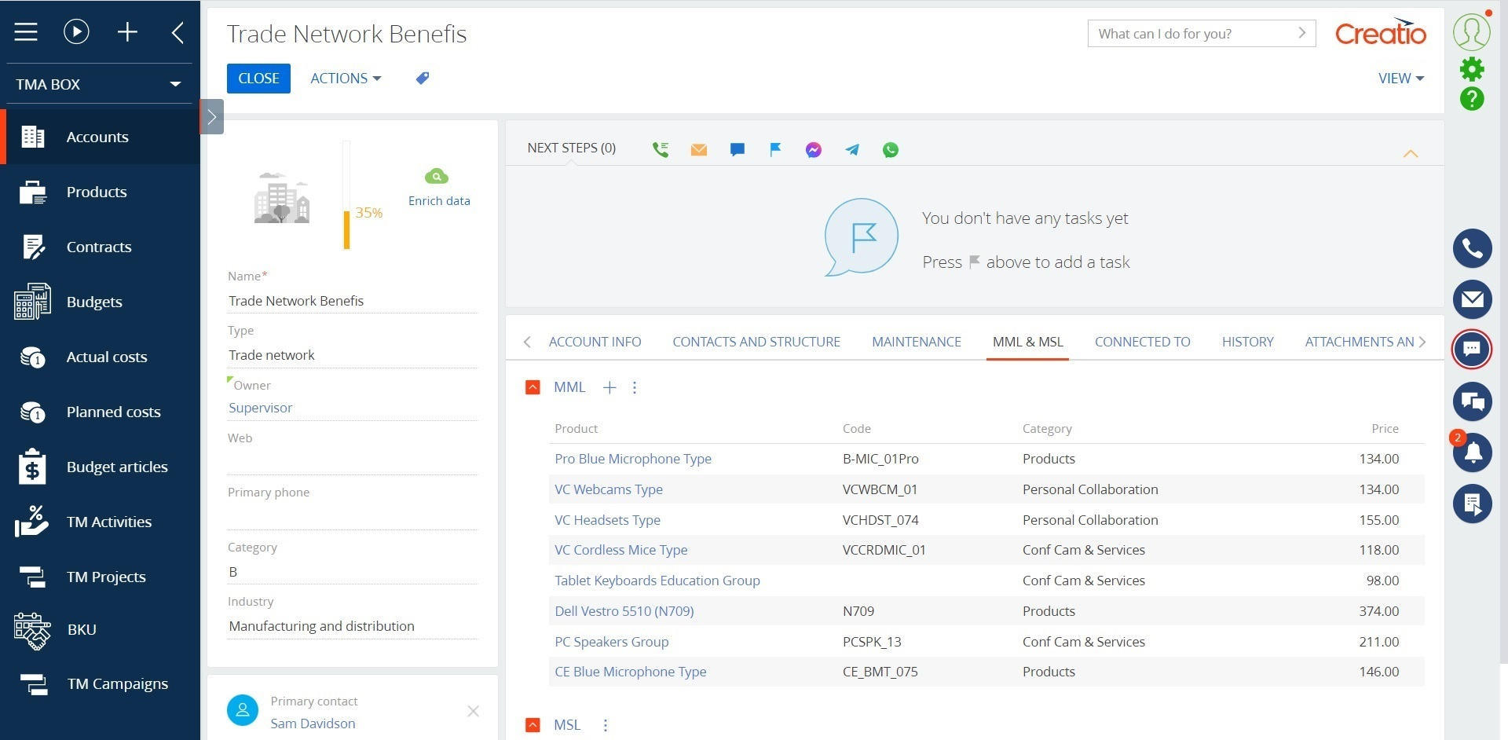
FMCG management for Creatio
Use cases:
Interactions with accounts;
Contract conditions management;
Budget management;
Promotional activities management;
Marketing calendar;
Order management.
Notes:
First of all, we normalize the client base and set up categorization and segmentation. The system allows you to use absolutely any information to categorize clients, from the size of the land bank to the number of goods purchased from us.
Also we calculate the potential of each client based on his land bank and grown
crops. Based on this information, we can prioritize the work of the manager and understand which customer have the maximum potential.
Also we maintaining information about competitor’s products to help the manager more carefully prepare for meetings with the client and consider with whom the client compares us.
and of course analytics. The system allows you to build analytics on any data that is in the system in any slices and views. this will allow you to analyze information in the most convenient form in a single system

Slide 4
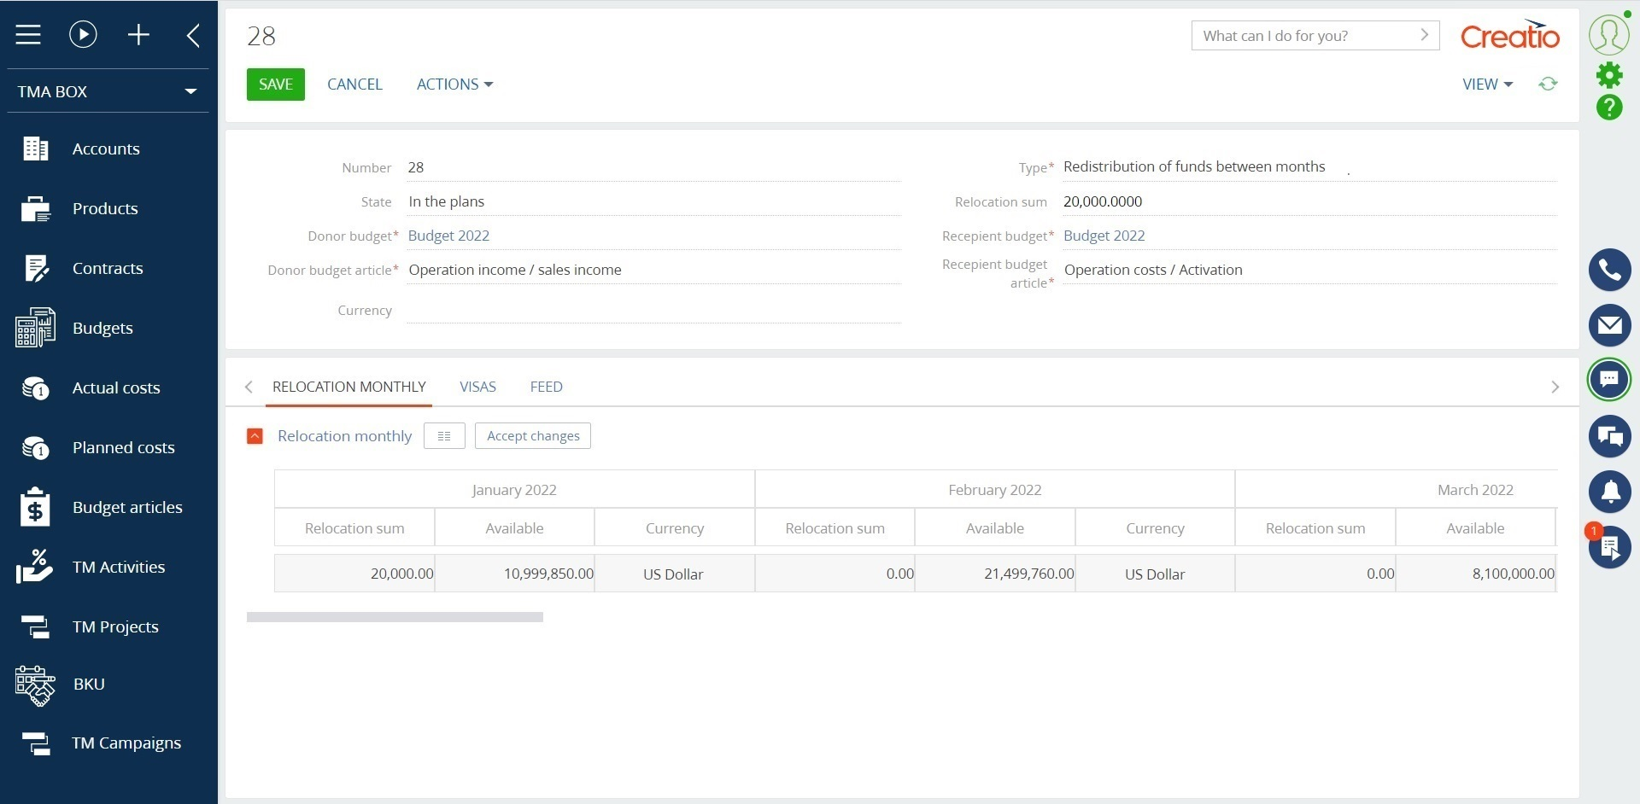
FMCG management for Creatio
Key features:
Full control over processes and complex solution of tasks of the trade marketing department at all levels of work: from management of global campaigns to control of cost items and shipments by points;
Management of interaction with trade networks and distributors on contractual terms and taking into account work models for long-term and short-term sales planning, keeping a history of trade-marketing activities with details to a specific point of sales;
Notes:
First of all, we normalize the client base and set up categorization and segmentation. The system allows you to use absolutely any information to categorize clients, from the size of the land bank to the number of goods purchased from us.
Also we calculate the potential of each client based on his land bank and grown
crops. Based on this information, we can prioritize the work of the manager and understand which customer have the maximum potential.
Also we maintaining information about competitor’s products to help the manager more carefully prepare for meetings with the client and consider with whom the client compares us.
and of course analytics. The system allows you to build analytics on any data that is in the system in any slices and views. this will allow you to analyze information in the most convenient form in a single system

Slide 5
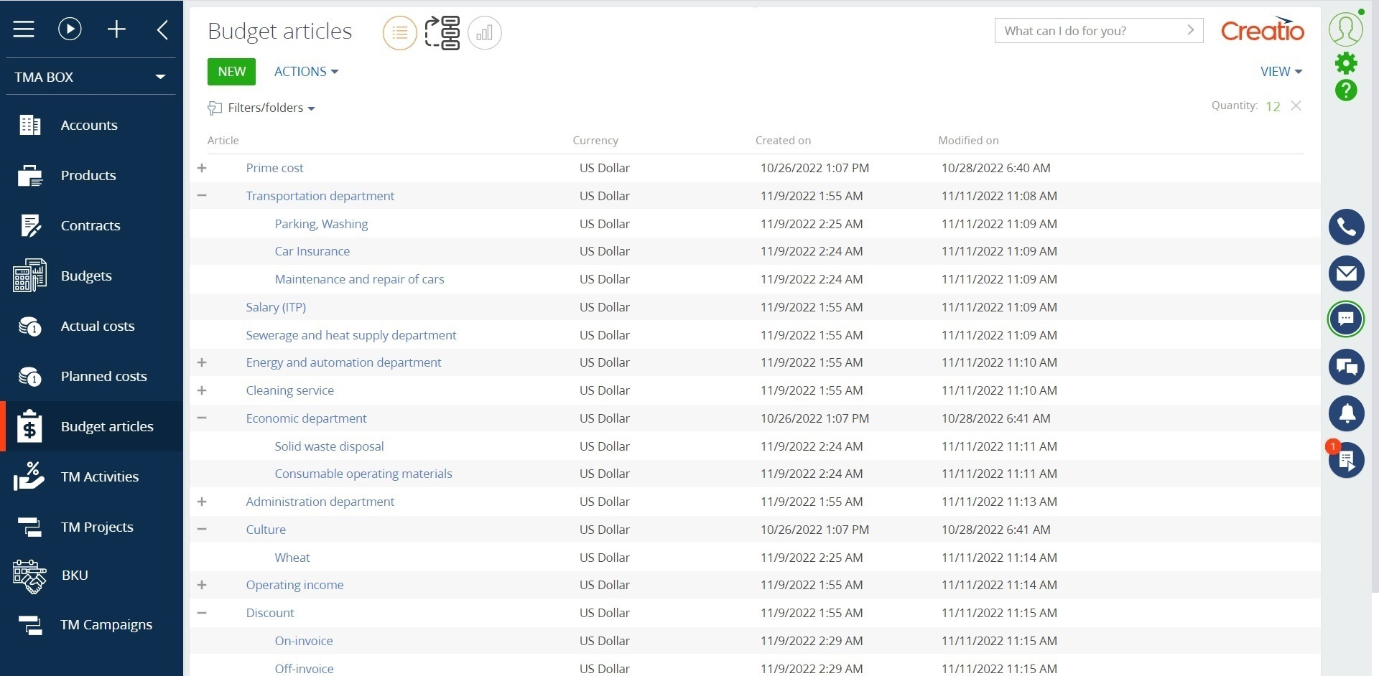
FMCG management for Creatio
Key features:
Shortening of planning, terms and provision of reporting with the help of a ready-made tool for drawing up and analyzing the budget of trade marketing activities at all levels of detail;
Acceleration of the main routine tasks of managers and minimization of errors caused by the human factor due to a single window for working with promotions and trade-marketing activities;
A convenient tool for visual display of the activity of the trade marketing department with interactive functions.
Notes:
First of all, we normalize the client base and set up categorization and segmentation. The system allows you to use absolutely any information to categorize clients, from the size of the land bank to the number of goods purchased from us.
Also we calculate the potential of each client based on his land bank and grown
crops. Based on this information, we can prioritize the work of the manager and understand which customer have the maximum potential.
Also we maintaining information about competitor’s products to help the manager more carefully prepare for meetings with the client and consider with whom the client compares us.
and of course analytics. The system allows you to build analytics on any data that is in the system in any slices and views. this will allow you to analyze information in the most convenient form in a single system

Slide 6
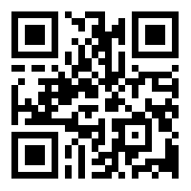
FMCG management for Creatio
CONTACT US:
salesup-it.com
care@salesup-it.com
Notes:
First of all, we normalize the client base and set up categorization and segmentation. The system allows you to use absolutely any information to categorize clients, from the size of the land bank to the number of goods purchased from us.
Also we calculate the potential of each client based on his land bank and grown
crops. Based on this information, we can prioritize the work of the manager and understand which customer have the maximum potential.
Also we maintaining information about competitor’s products to help the manager more carefully prepare for meetings with the client and consider with whom the client compares us.
and of course analytics. The system allows you to build analytics on any data that is in the system in any slices and views. this will allow you to analyze information in the most convenient form in a single system

