Slide 1


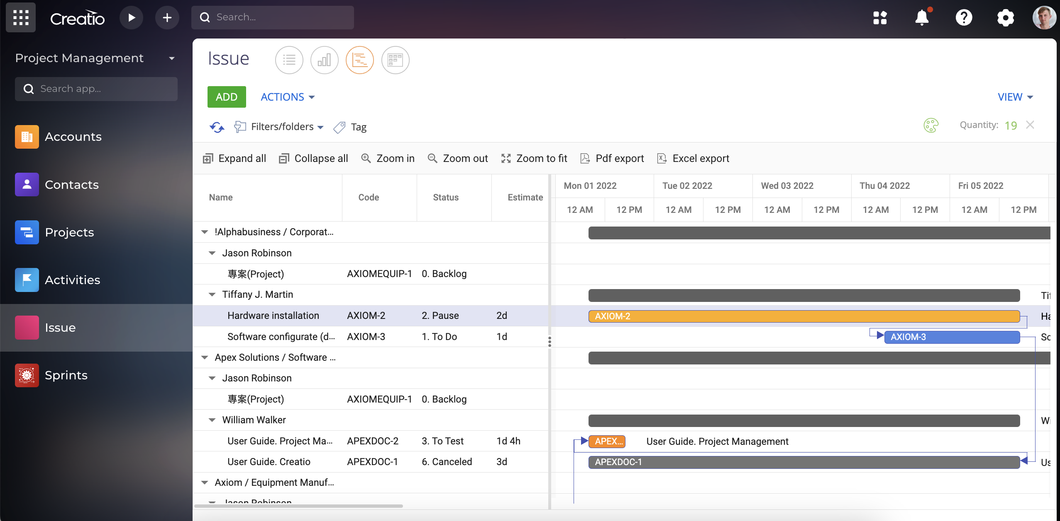
Project Management
Create your perfect project.

Slide 2

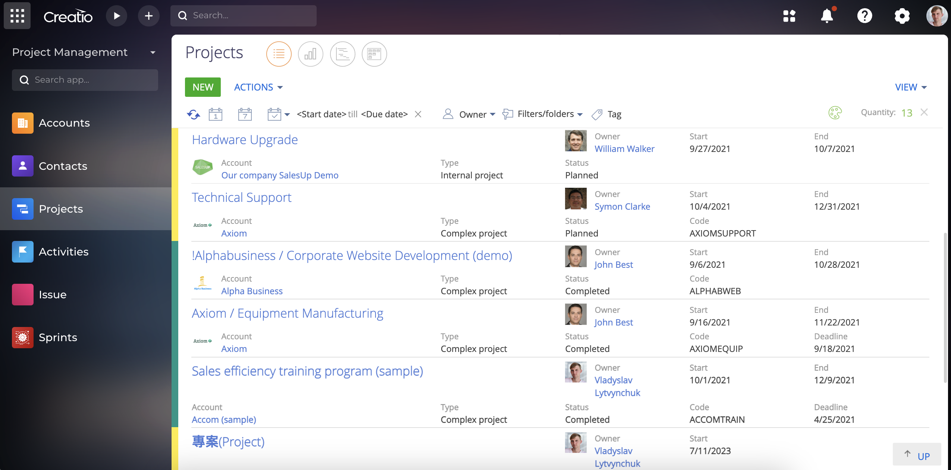
Project Management for Creatio
SalesUp Project Management for Creatio - The product allows you to plan, create and manage project tasks, monitor their progress, respond quickly to deviations from the schedule and changes in the priority of tasks using a convenient view in the form of Gantt chart and Kanban board.
Notes:
First of all, we normalize the client base and set up categorization and segmentation. The system allows you to use absolutely any information to categorize clients, from the size of the land bank to the number of goods purchased from us.
Also we calculate the potential of each client based on his land bank and grown
crops. Based on this information, we can prioritize the work of the manager and understand which customer have the maximum potential.
Also we maintaining information about competitor’s products to help the manager more carefully prepare for meetings with the client and consider with whom the client compares us.
and of course analytics. The system allows you to build analytics on any data that is in the system in any slices and views. this will allow you to analyze information in the most convenient form in a single system

Slide 3
Project Management for Creatio
Use cases:
The product helps manage project tasks at all levels, from planning to final product delivery. Setting up filters, displaying tasks on the Gantt chart and Kanban board will help you effectively track and analyze your team's performance. Compare management strategies and choose the best one for you.
Notes:
First of all, we normalize the client base and set up categorization and segmentation. The system allows you to use absolutely any information to categorize clients, from the size of the land bank to the number of goods purchased from us.
Also we calculate the potential of each client based on his land bank and grown
crops. Based on this information, we can prioritize the work of the manager and understand which customer have the maximum potential.
Also we maintaining information about competitor’s products to help the manager more carefully prepare for meetings with the client and consider with whom the client compares us.
and of course analytics. The system allows you to build analytics on any data that is in the system in any slices and views. this will allow you to analyze information in the most convenient form in a single system

Slide 4
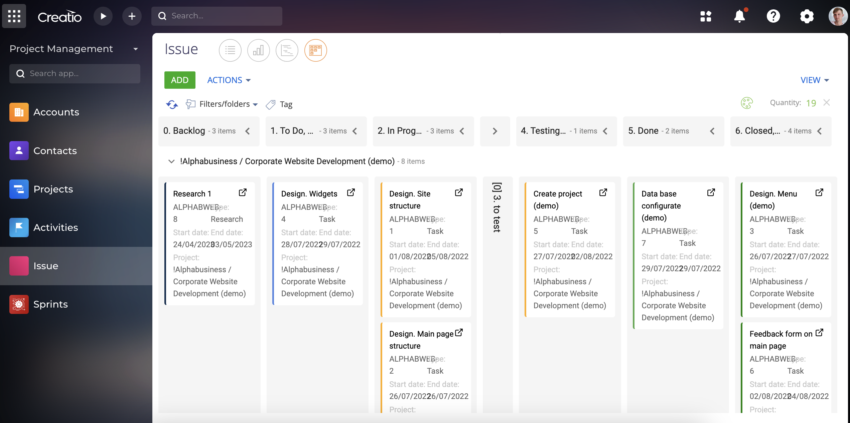
Project Management for Creatio
Key features:
Assign, monitor, and manage task stages;
Quick access to detailed task information;
Manage task priorities;
Identify weaknesses in project progress;
Detailed project tasks progress monitoring;
Analyzing resources spent on execution of tasks;
Control and optimization of employees' working hours;
Visualization of tasks, their number and execution stages on the Gantt chart and Kanban board.
Notes:
First of all, we normalize the client base and set up categorization and segmentation. The system allows you to use absolutely any information to categorize clients, from the size of the land bank to the number of goods purchased from us.
Also we calculate the potential of each client based on his land bank and grown
crops. Based on this information, we can prioritize the work of the manager and understand which customer have the maximum potential.
Also we maintaining information about competitor’s products to help the manager more carefully prepare for meetings with the client and consider with whom the client compares us.
and of course analytics. The system allows you to build analytics on any data that is in the system in any slices and views. this will allow you to analyze information in the most convenient form in a single system

Slide 5
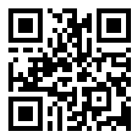
Project Management for Creatio
CONTACT US:
salesup-it.com
care@salesup-it.com
+38 050 140 11 22
Kyiv, Lobanovskoho Avenue, 119В
Notes:
First of all, we normalize the client base and set up categorization and segmentation. The system allows you to use absolutely any information to categorize clients, from the size of the land bank to the number of goods purchased from us.
Also we calculate the potential of each client based on his land bank and grown
crops. Based on this information, we can prioritize the work of the manager and understand which customer have the maximum potential.
Also we maintaining information about competitor’s products to help the manager more carefully prepare for meetings with the client and consider with whom the client compares us.
and of course analytics. The system allows you to build analytics on any data that is in the system in any slices and views. this will allow you to analyze information in the most convenient form in a single system

