Slide 1


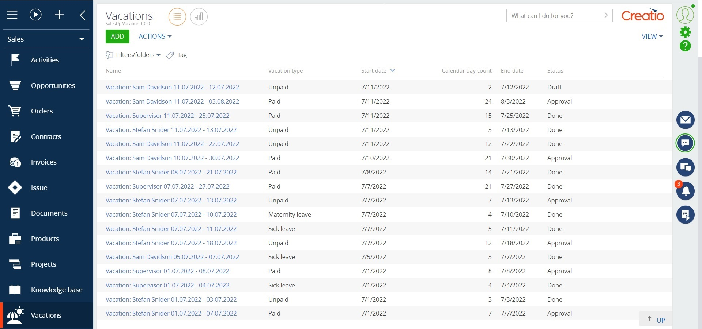
Vacation requests
Manage vacations with ease

Slide 2

Vacation requests for Creatio
Vacation requests for Creatio helps to keep records of system users' vacations by using Creatio system interface.
Notes:
First of all, we normalize the client base and set up categorization and segmentation. The system allows you to use absolutely any information to categorize clients, from the size of the land bank to the number of goods purchased from us.
Also we calculate the potential of each client based on his land bank and grown
crops. Based on this information, we can prioritize the work of the manager and understand which customer have the maximum potential.
Also we maintaining information about competitor’s products to help the manager more carefully prepare for meetings with the client and consider with whom the client compares us.
and of course analytics. The system allows you to build analytics on any data that is in the system in any slices and views. this will allow you to analyze information in the most convenient form in a single system

Slide 3
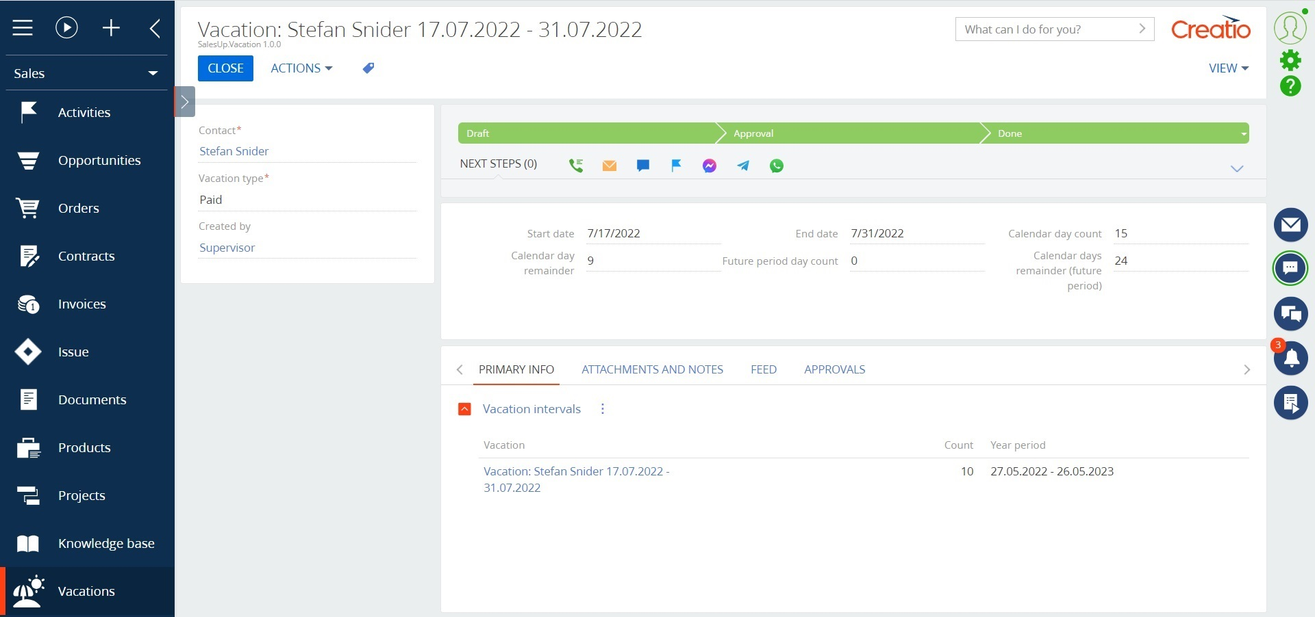
Vacation requests for Creatio
Use cases:
The app allows you to keep records of system users' vacations according to the following types:
Paid
Unpaid
Maternity leave
Sick leave
Notes:
First of all, we normalize the client base and set up categorization and segmentation. The system allows you to use absolutely any information to categorize clients, from the size of the land bank to the number of goods purchased from us.
Also we calculate the potential of each client based on his land bank and grown
crops. Based on this information, we can prioritize the work of the manager and understand which customer have the maximum potential.
Also we maintaining information about competitor’s products to help the manager more carefully prepare for meetings with the client and consider with whom the client compares us.
and of course analytics. The system allows you to build analytics on any data that is in the system in any slices and views. this will allow you to analyze information in the most convenient form in a single system

Slide 4
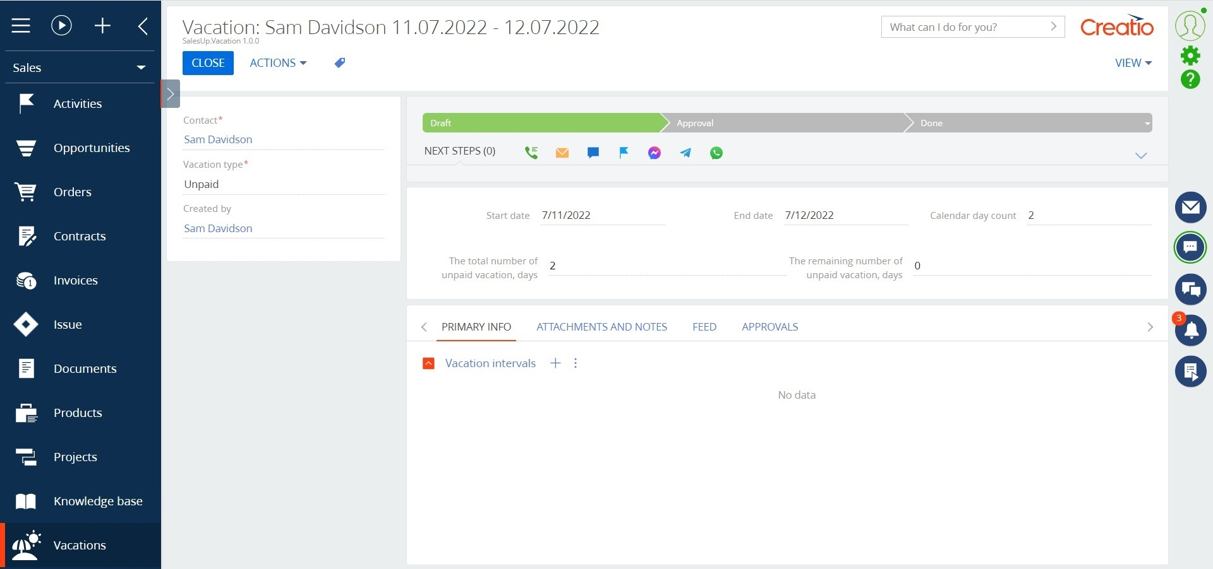
Vacation requests for Creatio
Key features:
Customization according to the individual characteristics of the company:
  number of vacation days per year;
  number of vacation days without pay;
  number of available vacation days from a future period;
Tracking annual vacation periods for each employee;
Notes:
First of all, we normalize the client base and set up categorization and segmentation. The system allows you to use absolutely any information to categorize clients, from the size of the land bank to the number of goods purchased from us.
Also we calculate the potential of each client based on his land bank and grown
crops. Based on this information, we can prioritize the work of the manager and understand which customer have the maximum potential.
Also we maintaining information about competitor’s products to help the manager more carefully prepare for meetings with the client and consider with whom the client compares us.
and of course analytics. The system allows you to build analytics on any data that is in the system in any slices and views. this will allow you to analyze information in the most convenient form in a single system

Slide 5
Vacation requests for Creatio
Key features:
Automatic accounting of employees' vacation days involved, in different annual periods;
Ability to configure automatic deduction of holidays in accordance with the individual characteristics of the company;
Accounting for all types of vacation for all employees;
Formation of a vacation period by the system, considering days involved only after approving vacation.
Notes:
First of all, we normalize the client base and set up categorization and segmentation. The system allows you to use absolutely any information to categorize clients, from the size of the land bank to the number of goods purchased from us.
Also we calculate the potential of each client based on his land bank and grown
crops. Based on this information, we can prioritize the work of the manager and understand which customer have the maximum potential.
Also we maintaining information about competitor’s products to help the manager more carefully prepare for meetings with the client and consider with whom the client compares us.
and of course analytics. The system allows you to build analytics on any data that is in the system in any slices and views. this will allow you to analyze information in the most convenient form in a single system

Slide 6
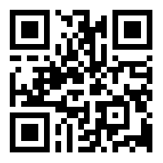
Vacation requests for Creatio
CONTACT US:
salesup-it.com
care@salesup-it.com
Notes:
First of all, we normalize the client base and set up categorization and segmentation. The system allows you to use absolutely any information to categorize clients, from the size of the land bank to the number of goods purchased from us.
Also we calculate the potential of each client based on his land bank and grown
crops. Based on this information, we can prioritize the work of the manager and understand which customer have the maximum potential.
Also we maintaining information about competitor’s products to help the manager more carefully prepare for meetings with the client and consider with whom the client compares us.
and of course analytics. The system allows you to build analytics on any data that is in the system in any slices and views. this will allow you to analyze information in the most convenient form in a single system

